Slide 1
UNM Hospitals & Sandoval Regional Medical Center Application Processes

Slide 2
Applying to UNMH positions
Go to www.unmhjobs.com
Search positions and apply
Set up new account or login to existing account
Tips:
Enter all work history
Enter minimum of 5 references (minimum 3 are supervisors)
Upload cover letter at front page of resume/cv (only one doc allowed) MS Word
Respond ASAP to reference check and behavioral assessment requests (online)

Slide 3
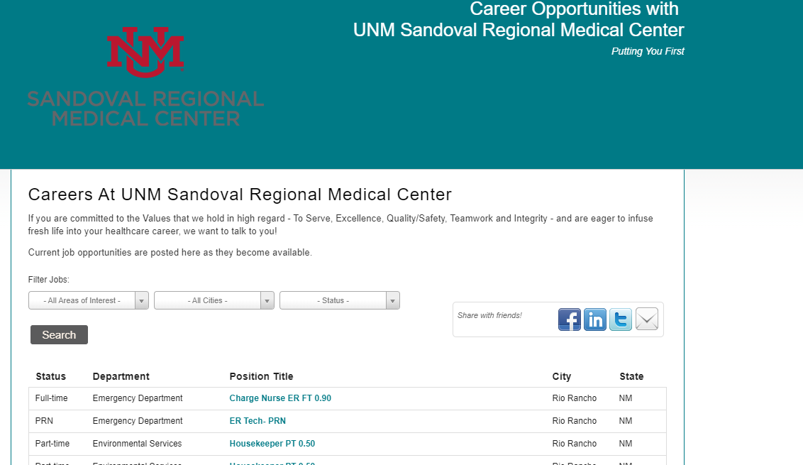
Applying to UNM SRMC’s Career Opportunities
Scroll down on our home page to Career opportunities →
Click View Current Openings and you will be directed to our career opportunities page
All job opportunities will be available on our opportunities page →
Once your application is complete, you will receive a confirmation email that we have received your application.
Our hiring managers will source applications and send a correspondence via email to inform where you stand in the hiring process.
If you have not heard back from hiring manager(s)- please contact 505-994-7000 and you will be directed to our HR personnel.

Slide 4
Tips for Applying and Interviewing
Start by researching the company and your interviewers
Practice your answers to common interview/behavioral questions
Reread the job description
Prepare a list of references, and examples of your work
Prepare smart questions for your interviewers
Plan your interview attire the night before
Bring copies of your resume ( List the last 10 years of employment/ relevant experience)
Plan your schedule to arrive 10-15 min early
Use the Star Method when answering questions
Make a great first impression and treat everyone you encounter with respect.
Keep answers concise and focused
Ask about next steps- do not be afraid to ask questions

